Slide 1
Challenging the Neoliberal Consensus: The Global Justice Movement

Slide 2
Film & Building Democracy
Lessons From Seattle?
Relationship Building
Issue Organizing
Popular Education
Community Leading

Slide 3
Seattle Conclusion:
Global Justice: Seattle marked the coming out party for the global justice movement: A global Countermovement—or what some have called a transnational counterpublic—sites of counternarratives about who they are, what they need…..
Coalition: A highly diverse set of organizations ranging from the local to the global, using the tools of globalization to coordinate its transnational activities throughout the “North” and “South.”
Anti-traditional politics: Not about capturing political office—change without taking power; no defined leadership hierarchy.
Exclusion: Motivated by the failure of the neoliberal globalization to more widely distribute the costs and benefits of change.
Transition point: Although protests against the IMF, World Bank, WTO, NAFTA are not unique, Seattle was the first major expression of the breadth of the global justice movement; Seattle brought together people and organizations from all over the world—physical, spiritually, and emotionally.

Slide 4
In the end, Seattle was about:
Education, Information, and Dialogue: to challenge the consensus and to open up a broad dialogue about globalization; a debate up to this point had not existed. Most people in the US knew very little about the WTO, World Bank, the IMF; globalization & Seattle changed this.
Transparency and Accountability: The need for greater transparency and accountability regarding the organizations central to deepening and expanding neoliberal globalization.
Democracy: that building democracy begins from below in constructing community-based decision-making power by mobilizing communities & activists across the globe as a counter to the might of TNCs .

Slide 5
Hope and Challenge of Seattle:

Slide 6
Hope:
Hope: Seattle built upon earlier organizing and demonstrated the potential of an emergent global civil society* upon which new forms of political activism can be built.
  *Civil society defined as that “3rd sector” that attempts to mobilize groups to change policy and to shape the social order.

Slide 7
Challenge:
Challenge: Seattle brought together the various currents of the Anti-corporate globalization movement and showed the world what these groups were against, yet those at Seattle failed to articulate a vision. In the end, people were asking, what does it all mean:
What does it mean that “Another World is Possible”;
No one really knew.

Slide 8
The WSF
The World Social Forum emerged from the Challenge of Seattle, and the growing dissatisfaction of existing global mechanisms to resolve the contradictions of global capitalism & to challenge the World Economic Form--an annual meeting in Davos Switzerland bringing together business leaders and government officials to set global rules.
WSF: founded in Porto Alegre in January 2001 by European and local Brazilian NGOs and activists.
Its focus has revolved around four thematic areas:
  production of wealth and poverty.
  access to wealth and sustainability.
  empowering civil society and the public realm.
  political, power and ethics in the new society.

Slide 9
Participants at the World Social Forums recognized the spatial connections of inequality; solving local problems requires addressing them globally. Thus the need for a global forum.
Growth:
  25,000 to close to 200,000 at various Forums
Locations:
  WSF1-3 = Porto Alegre, Brazil.
  WSF4 = Mumbai, India.
  WSF5 = Porto Alegre, Brazil.
  WSF6 = Polycentric (Venezuela, Mail, Pakistan).
  WSF7 = Nairobi ,Kenya.
  WSF8 = “placeless” Global Call for Action.
  WSF9 = Belem, Brazil.
  WSF10 = the 10 year anniversary (27 regional, national & local events).
  WSF11 = Dakar February 6 to 11 2011.
  WSF12 = Porto Alegre, Brazil.
  WSF13 = Tunis, Tunisia
  WSFM14 = South Africa—WSF on Migration
  WSF15 = Tunis, Tunisia
  WSF16 = Montreal, Canada
  WSF17 = Porto Alegre, Brazil: Forum on resistance
  WSF18 = Fukuoka, Japan; Security and Equality for Sustainable Futures

Slide 10
Some Basic Characteristics:
Space: the WSF is a convergence “space” for all local activists & organizations and share experiences, forge new networks and new ideas about solving local problems—many of these threads had been developing separately but simultaneously throughout the world.
  Some call it a “new global politic”, a common public space where previously excluded voices can speak, act, and organize.
Education/Democracy: continues in the education and information spirit of Seattle, attempting to broaden and deepen the countermovement as a means to combat neoliberalism globally and locally and shift the movement’s focus from anti- to pro: Anti-globalization to Pro-democracy—to democratize the global system—to Global climate politics—a merging between global justice and environmental/climate politics.
The Goal:
  To devise alternatives to TINA by promoting plural, diverse, non-governmental and non-partisan debate capable of generating a process of change from below based on inclusion & social justice and opposed to an industrial, productivist and consumerist civilization.
  To build a new paradigm of social, economic and political organization.
  https://www.youtube.com/watch?v=TlIwAPitMK4

Slide 11
Global - Local:
Seattle and the WSF raised critical question:
Global Integration: Are markets the only and best mechanism of global integration and advancing human wellbeing, or are there other more positive mechanisms?
Human Needs: The neoliberal model assumes elites and corporations can or will address the needs of the majority; is this likely or possible?
Transformation: The Countermovement assumes neoliberal globalization can be transformed through multi-level pressure on governments and corporations:
Which raises an additional question: How?
How can a process of change be engendered that both hears and responds to the voices of the most marginalized members of the Human Community?
What’s Missing?
      Local capacity.
Here we turn to Saul Alinsky

Slide 12
Community Organizing and Social Capital:

Slide 13
Alinsky:
Coalition Building: Unions and Community Organizing have a long history in the U.S;
Alinsky: The standard reference point for the Empowerment model of Community Organizing dates to Alinsky’s work in the 1930s to build a new type of community organization based on empowerment—
  the very term community organizing is inextricably linked to Alinsky;

Slide 14
Background
As a graduate student at the U of Chicago, he participated in programs to create community organizations to combat the community disorganization afflicting ethnic neighborhoods in Chicago.
Assumptions: Prevailing theories assumed that community disorganization was rooted in cultural differences. Neighborhoods sustained cultural differences through ethnic organizations which produced community disorganization—and thus marginalization.
Goal: The early Chicago programs were intended to foster social integration of community residents by facilitating cultural assimilation.
Critique: Alinsky argued that the cultural perspective ignores the political sources of disorganization & marginalization: it is the power business and governments exercise over the lives of neighborhoods residents—not cultural differences—that matter.

Slide 15
Background Cont.
CIO: Alinsky also worked with the John L Lewis, head of the then recently formed Congress of Industrial Organizations. Famous CIO (industrial) unions included the mine workers & Longshoremen. The CIO led the Flint sit-down strikes leading to GM recognizing the UAW—Auto Workers.
  Key element of the CIO strategy was worker empowerment; workers functioned as a union on the shop floor before the union was formally established—this is the lesson Alinsky learned: organize the community first; make demands second.

Slide 16
Back of The Yards Neighborhood Community
Back of the Yard Neighborhood: Alinsky began working in the neighborhoods surrounding Union Stockyards in Chicago; site for Upton Sinclair's book The Jungle.
Model: Here he developed his strategy of coalition building & mobilization with power at the core.
The Back of the Yard Neighborhood Council: established in 1939 by Saul Alinsky and Joseph Meegan, is considered to be one of the oldest community organizations in the United States.
Goal: community control over the community’s future based on organized and empowered residents.

Slide 17
BOTY Demographics:
General: The Back of The Yards Neighborhood has historically served as a gateway for immigrants into Chicago.
1900:
  Dominated by Slavic enclaves; Poles, Lithuanians, Slovaks, and Czechs, with most communities organized around ethnic parishes—with a head priest from the home country, its own school, men's and women's clubs and sports associations—serving as social, cultural, and spiritual focal points for residents' lives.
1920s:
Small numbers of Mexican immigrants entered Back of the Yards and neighboring Bridgeport, but the community retained its Slavic character until the 1970s.
    2000:
    Latinos: From Mexico & Central America

Slide 18
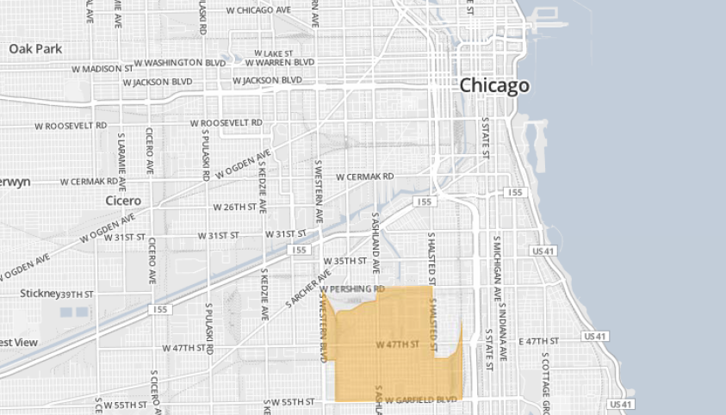
Miracle Mile
Central Chicago
Bridgeport
Back of the Yards
Neighborhood
Notes:
The Back of the Yards neighborhood was originally part of the Town of Lake until its annexation by Chicago in 1889. The expansion of the neighborhood began in the mid–nineteenth century with the establishment of the Union Stockyards and the concentration of railroads in the area. By 1900, the neighborhood had been transformed into a series of Slavic enclaves, dominated by Poles, Czechs, Lithuanians, and Slovaks, largely composed of workingman’s cottages.
Prior to the Great Depression, these enclaves handled their population’s problems internally.
When the Great Depression hit, poverty and need were so widespread that the enclaves simply could not cope within their individual ethnic communities.

Slide 19
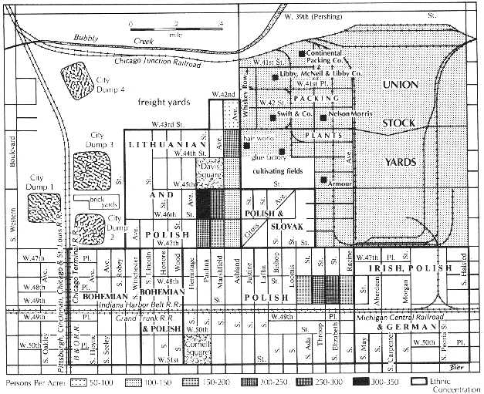
Map of BOTY: Ethnic Enclaves, surrounded by RR, city dumps and stockyards. Residents used the many city dumps for “shopping.”

Slide 20
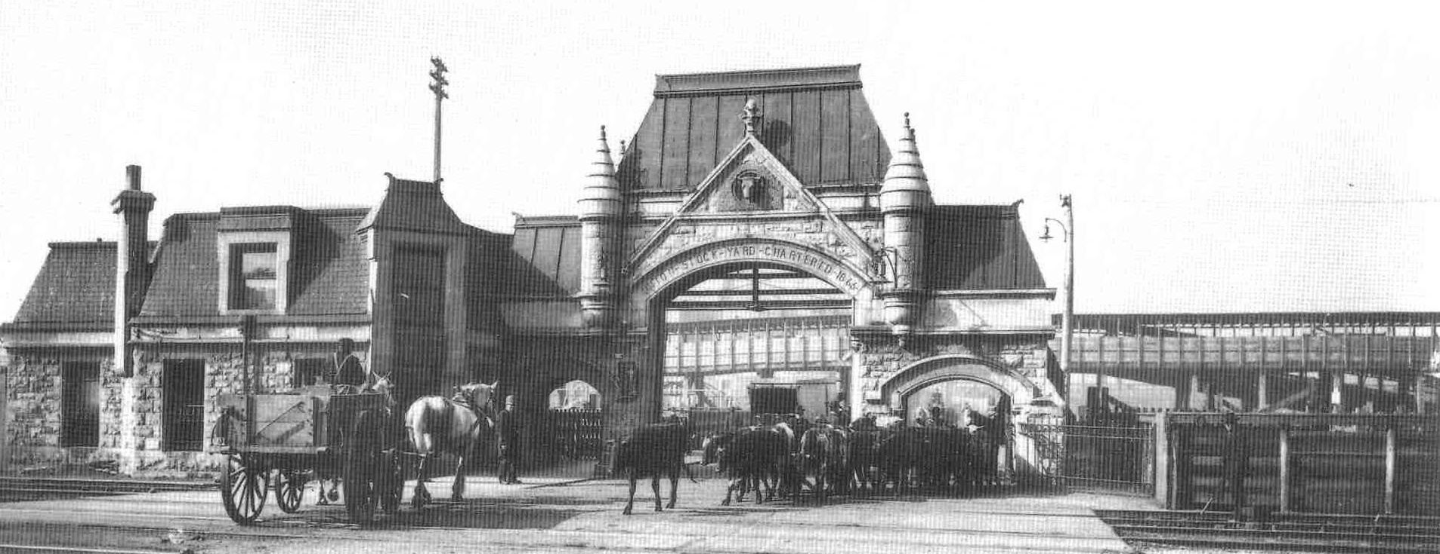
Gate to the Chicago Union Stockyards

Slide 21
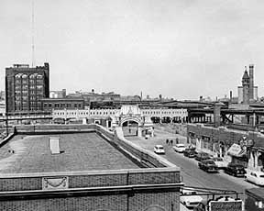

Slide 22
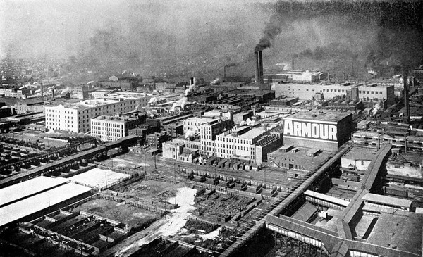
By 1880, Armour was Chicago's most important business and helped make the city and its Union Stock Yards the center of the American meatpacking

Slide 23
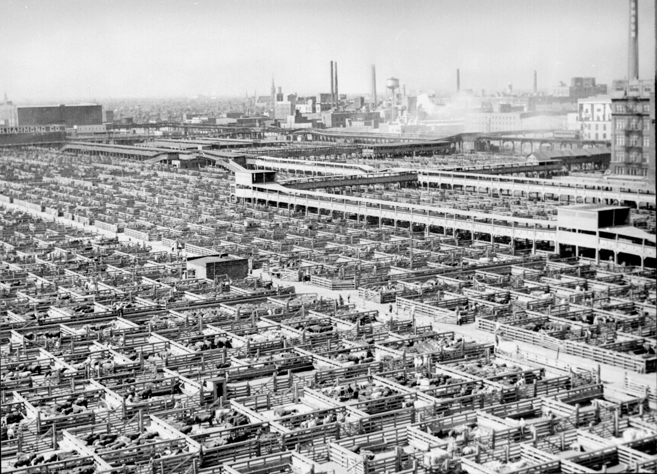

Slide 24
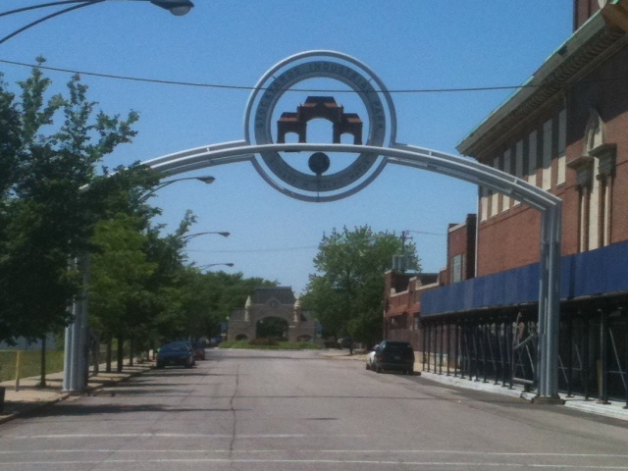
Arch that denotes the location of the Union Stockyards. Until 1955 it was the largest livestock yard and meatpacking center in the U.S. (replaced by Omaha). After the Stockyards closed in 1971, The Back of the Yards Council worked to transition the area into an industrial park for economic and community development programs.

Slide 25
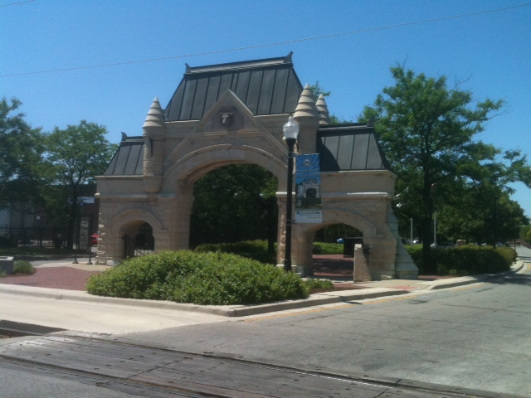
All that remains of the Chicago Union Stockyards.

Slide 26
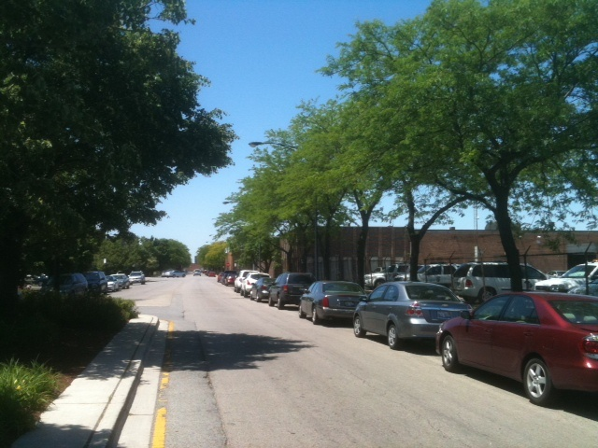
What the Union stockyard complex looks like today (looking behind the old archway).

Slide 27
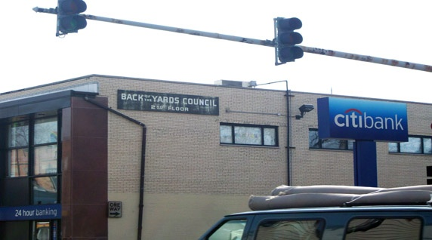
Back of the Yards Neighborhood Site Today
https://search.alexanderstreet.com/view/work/bibliographic_entity%7Cvideo_work%7C3217072

Slide 28
Alinsky’s Model:
Assumptions: Power is dichotomous and zero-sum: You either have more of it or less of it, and the only way to get more is to take it from someone else; Power is never given, only taken;
Self-interest: Modern society is created out of a compromise between self-interested individuals, Thus organizing requires appealing to people’s self interest. People become involved because they think there is something in it form them—issue of “buy-in”;
Conflict: Conflict is inevitable;
  Note: for Alinsky an organizer begins with how things are, not how s/he would like things to be. But whether Alinsky believed self-interest to be part of human nature is not clear, nor did Alinsky spend much time on it. He worked with what he had, not with what he wanted…..Second, Alinsky also felt that through this process people could learn to act out of compassion and altruism; a result of the organizing process.

Slide 29
Alinsky on Democracy, Power and Empowerment:
Democracy: A process; a means through which people participate in deciding the rules and conditions of their lives. Democracy is impossible under conditions where power is unequally distributed or where people don’t have power; (politics is a struggle over who gets what)
Empowerment: A multidimensional social process that involves developing a sense of efficacy. It is a process that fosters consciousness raising and the skills to take control over one’s life-in our communities and in our society by acting on issues we define as important;
  Note: Empowerment vs. “empowerment”: “empowerment” defined in terms of market participation vs. Empowerment defined in terms of a people’s abilities and capabilities to act and define how change should proceed. People have power, but are often disempowered by social institutions, culture,…

Slide 30
Building Power:
Power: For the Community, Power is partly based on numbers but also on capabilities: Building power (and engendering empowerment) begins with specific tangible problems that matter to people. This emerges from a dialogue among those most affected.
And based on
Relationships: Created through face-to-face organizing.
A Deliberative process that is
  Inclusionary: Includes those affected by the problems as well as public officials close to them.
  Participatory: Those most affected deliberate and define actions or and/or solutions to the problem(s) they identify.

Slide 31
Elements of the Model
Coalition Building:
  Organization of Organizations: Build power by mobilizing existing organizational resources into a single community organization: Faith-based, labor, student, environmental, community-based orgs, clubs, etc.
  Empowerment through Confrontation: empowerment emerges through actions: strikes, pickets, boycotts, public embarrassment of businesses…
  Capacity building: The Iron Rule—never do for others what they can do for themselves. This develops new leaders, community residents with new skills, and an informed and engaged citizenry.
Self-reflection and Monitoring: Ongoing reflection on strategies and tactics, to learn from the process, to coordinate the activities of stakeholders; holding those in power accountable by monitoring their actions.

Slide 32
Summary
Goal: building a people’s organization capable of realizing community control over the decision that affect the community—a community driven process of change.
  Sites of Power: the community organization for Alinsky was intended to be to the community what unions are to the workplace; sites of power to challenge the power of business and political elites and to serve as incubators of leadership building and thus participatory democracy.
Empowerment and democracy are built into the process and the organization-of organizations to serve as an incubator of empowerment, leadership development, and democracy.
Relationships: Building networks among similar people and across dissimilar people.
Thus, it is really a process of creating social capital:
And here we turn to Putnam

